Slide 1
IBM StepZen Graph Server Integration Talk Tuesday
30 May 2023

Slide 2
Agenda
Intro/context (recap from last, why is GraphQL important?)
Use Cases (Why is this relevant to you?)
Personas (How do you know you’re talking to the right person?)
Prospecting (of my 100 accounts, who do I start with?)
Deeper Dive into what StepZen Does
Competition
Pricing , licensing terminology and Sizing
How to request help
Upcoming Enablement

Slide 3
Context Why does this matter? -Brian

Slide 4
Opportunity: GraphQL
GraphQL usage is growing fast and is a good fit for connecting mobile and web user interfaces. Its use cases are also expanding to include data publication and normalization of diverse back-end APIs.²
GraphQL APIs will also expand into data sharing and integration-centric use cases, driving demand for better native GraphQL support from business intelligence (BI), self-service analytics, integration platforms and low-code application platforms (LCAPs).
By 2025, Gartner forecasts that more
than 50% of enterprises
will use GraphQL in production¹.
GraphQL does not fall into an existing, established market but sits at intersection of 3 related markets:
API Management $2.2B in ‘22 (16.7% CAGR)
Data Integration $8.4B in ‘22 (8.5% CAGR)
App Dev $8.9B in ‘22 (7.2% CAGR,).³
Sources:
1. Gartner Predicts 2022: APIs Demand Improved Security and Management,December 2021; 2. Choosing an API Format: REST Using OpenAPI Specification, GraphQL, gRPC or AsyncAPI
3. IDC Software Forecaster, Nov 2022 (Data Integration & Intelligence, API Management and Gateways, Application Development)
Notes:
GraphQL Opportunity
Gartner Analysis of GraphQL
By 2025, more than 50% of enterprises will use GraphQL in production, up from less than 10% in 2021
GraphQL APIs will also expand into data sharing and integration-centric use cases, driving demand for better native GraphQL support from business intelligence (BI), self-service analytics, integration platforms and low-code application platforms (LCAPs).
GraphQL usage is growing fast and is a good fit for connecting mobile and web user interfaces. Its use cases are also expanding to include data publication and normalization of diverse back-end APIs
GraphQL does not fall into an existing, established market but sits at intersection of 3 related markets: Data Integration $8.4B in ‘22 (8.5% CAGR, 23.5% cloud), App Dev $8.9B in ‘22 (7.2% CAGR, 17.1% cloud), API Management $2.2B in ‘22 (16.7% CAGR, 26.4% cloud)
Sources:
Gartner Predicts 2022: APIs Demand Improved Security and Management, December 2021; Choosing an API Format: REST Using OpenAPI Specification, GraphQL, gRPC or AsyncAPI
IDC Software Forecaster, Nov 2022 (Data Integration & Intelligence, API Management and Gateways, Application Development)

Slide 5
Core Problem: Speed of app development is hindered by complicated service & data silos
“Our data is scattered in multiple SAP and Oracle systems, slowing down applications that need longitudinal view of our customers.”: CTO, Fortune 500 Enterprise Cloud Company

Slide 6
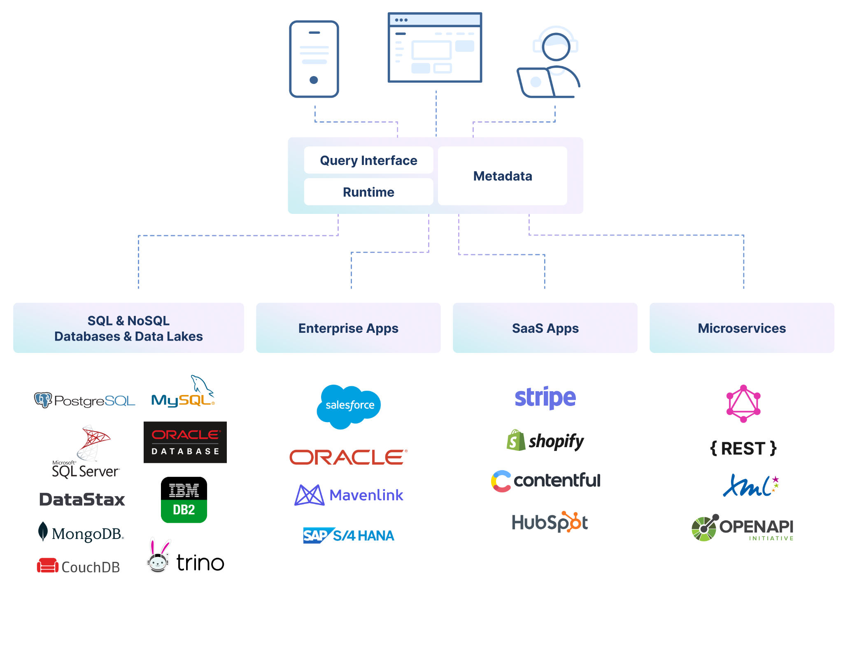



How to access diverse, complicated silos?
?
GraphQL

Slide 7
Solution: A GraphQL API that abstracts the backends away
“A single GraphQL API that covers our Postgres, Salesforce and CMS systems and delivers an integrated view is what we need”: Development Lead, Industrial Manufacturing Company

Slide 8
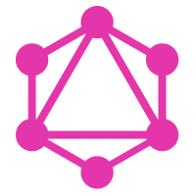
GraphQL APIs enable access to diverse sources
Frontend developers love GraphQL: - Very easy to consume
- All backends get abstracted away
Backend developers like GraphQL: - Lets everyone move faster
- But struggle with success:
- skills
- scale, support and maintenance
GraphQL
GraphQL

Slide 9

Use Cases

Slide 10
In General
Anywhere a web API and JSON might be used, GraphQL can be used.
However
JSON and web APIs are not the best choice for everything.

Slide 11

Technology Equipment Manufacturer - GraphQL on Cloud Database to combine with GraphQL CMS for web content delivery - Rapid development and success lead to adding CRM data to the API - “Curation” of third party GraphQL APIs to improve usability and product fit with their GraphQL API design patterns

Slide 12

Technology Provider - Standardized on GraphQL for both external API capability and internal development - Multiple enterprise systems including SAP - Improved usability of APIs along with simplifying the cross-domain view of the company

Slide 13

IT Services Company - GraphQL on Data Warehouse knowledge - Combined with CRM and other revenue recognition systems - GraphQL API made web development easy without requiring deep knowledge of back end systems

Slide 14

Digital Marketing Agency - GraphQL on Third party REST API - Backend-for-Frontend (BFF) pattern for internal applications - Simplified a complex API and ensured only necessary data was available - Migrated third party providers without API disruption

Slide 15
Personas - Carlos

Slide 16
Am I talking to the right person?
The decision maker will be either:
At the intersection of multiple departments and struggling with that complexity or
Feel pain right now from change requests and development speed
CTO, VP of Digital, VP of Mobile, lead on Integration or API, Head of Enterprise Architecture

Slide 17
Am I talking to the right person?
The trusted advisor will be:
API teams
Data teams
Architecture groups

Slide 18
Am I talking to the right person?
The verticals most ready:
Banking/Finance
Retail
Logistics
Any company

Slide 19
Finding Opportunities
Who
CTO, Lead Engineer, Lead Architect
Verticals
Banking/Finance, Retail, Logistics
Groups
API Management
Already using GraphQL
Sharing GraphQL APIs with customers and partners
Enterprise Architecture
Standardizing on GraphQL
GraphQL used with some teams in org
Creating an “enterprise graph”
Data Teams
Enabling application developers
What to listen for
Application modernization
API modernization
“Backend for Frontend”
Data modernization
“Data for all”
Democratize access to data
Enterprise Graph
Federation

Slide 20
Prospecting - Newton

Slide 21
Prospecting Introduction
First steps on building your lead list and using key prospecting tools.
Buyers to target:
CxO/Chief Innovation Officer/Chief Digital Officer: What they’re looking for: Cost (TCA & TCO) & skills in market; compliance with corporate governance and security requirements; adoption risk – balance customer like me vs. providing an innovative edge.
Enterprise/Data Architect: Wants to: Design, guide and build complex apps/data access across teams or companies. Persona Objective: Sets technical strategy. What they’re looking for: Is hands on and wants to use the tech themselves; needs to understand scaling and non-functional requirements (NFRs); will be concerned about developer productivity and user scale out; synergy with other tools already in use
End users:
Software Developer, or: Software Engineer, Application Developer, Application Engineer, Programmer Analyst, Software Development Engineer
Software Architect, or: Solutions Architect, Technical Architect, Application Architect, Infrastructure Architect, IT Architect

Slide 22
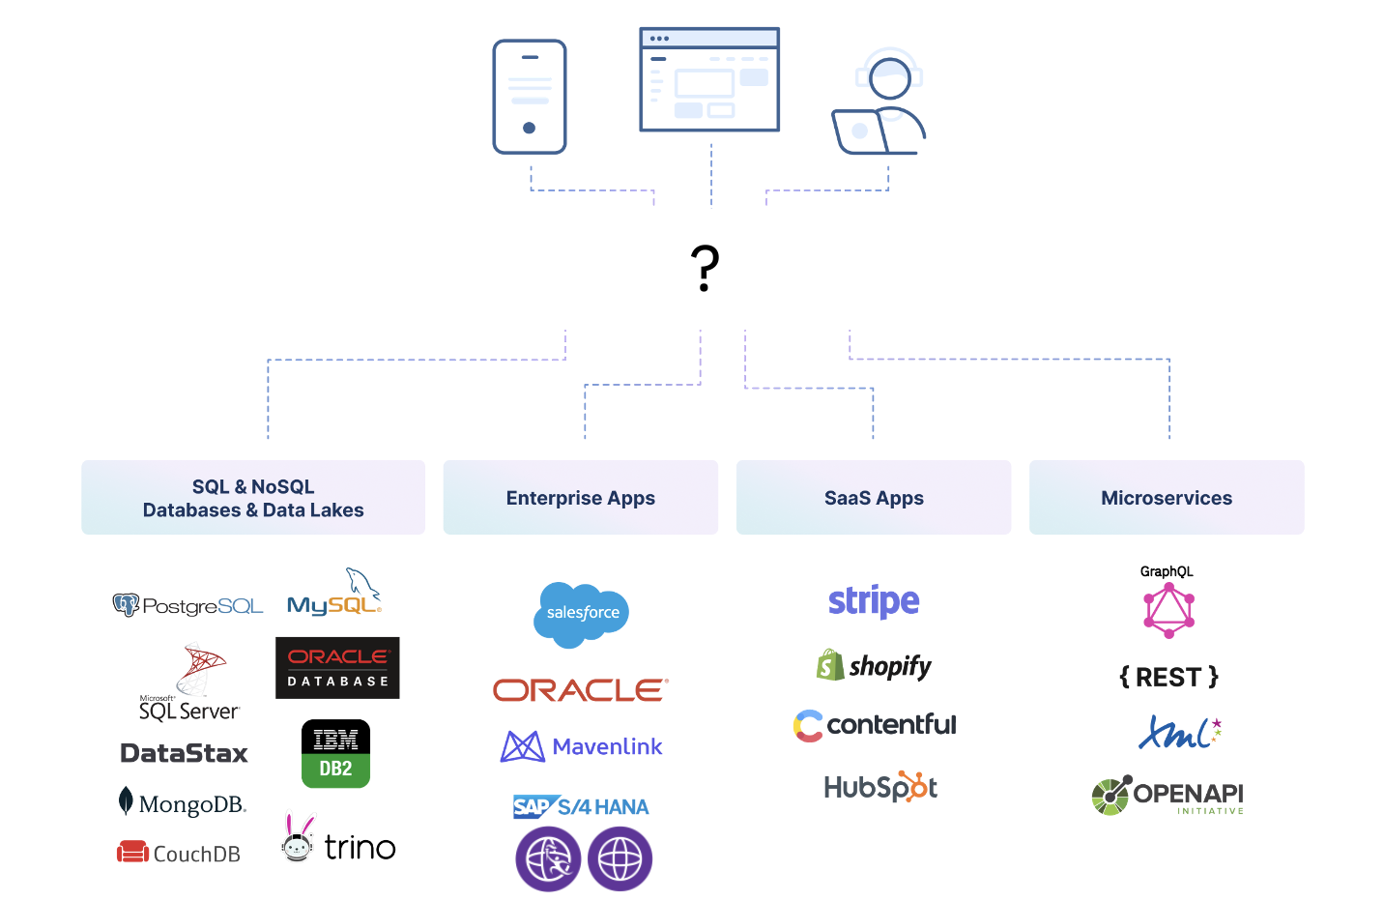
Step 3A: Learn the Problem Prepare for the first conversation you have with your prospect, whether that be a response to an email or cold call. Your goal is to book a meeting or discovery call.
Core problem: The speed of app development is hindered by complicated service & data silos
Organizations need to access diverse and complicated data silos

Slide 23
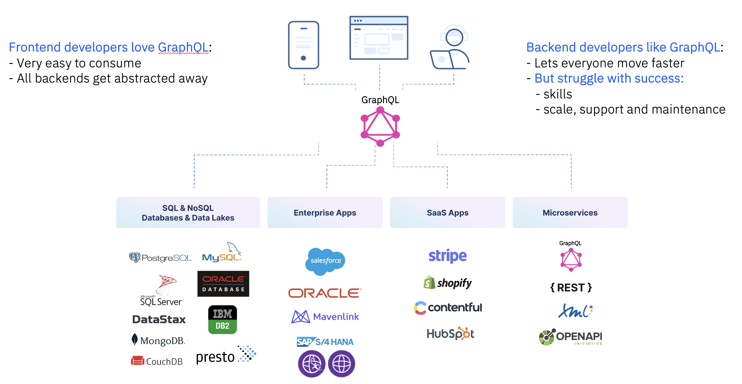
Step 1: Learn the solution Prepare for the first conversation you have with your prospect, whether that be a response to an email or cold call. Your goal is to book a meeting or discovery call.
A GraphQL API that abstracts the backends away
StepZen is a GraphQL server with a unique architecture that helps developers build APIs fast and with less code (using declarative configurations). APIs run in an in-memory Golang-based GraphQL engine deployed into Kubernetes and are highly responsive to application needs.
With StepZen’s declarative approach developers can build GraphQL APIs (and federated graphs) by composing GraphQL building blocks to create the GraphQL schema. Strong introspection capabilities mean that a GraphQL model for enterprise data can be constructed and composed with only a few lines of code.
Because you build your APIs declaratively, StepZen understands the API and can make optimization decisions at runtime, delivering low latency and high throughput and imposing a minimum burden on the backends.
To learn more: https://stepzen.com/why-stepzen

Slide 24
Step 2: Prospect Start Prospecting with your Targeted Lead List using the Multi-Touch Outreach provided in the following slides.
Prospecting Overview:
Follow these steps to facilitate a multi-touch outreach that spans 9 touches to your customer. Use your best judgement and review these quick tips before starting.
Note: If you have a prior relationship with a customer, you may want to modify this cadence and complete 2-3 touches.
Common Questions regarding Multi-Touch Outreach:
“Why engage in Multi-Touch Outreach?”
It is known that it takes 8 touches to book a meeting with a customer you do not already have a relationship with.
“Why personalize my outreach?”
The buyer persona in B2B is more complex than ever in 2021 - 90% of C-Suites ignore emails that do not have a personalized touch.
“Why should I use InMail over Email?”
There is a higher likelihood your email may go to your customer’s junk folder.
LinkedIn InMail allows for your customer to research who you are and learn that you are credible source at IBM.
LinkedIn will continue the conversation naturally - the more you post to your network, the more you are showing up for your customer as an SME outside of your prospecting outreach.

Slide 25
Step 3: Prepare Prepare for Client Conversations Your customer answered either your phone call or email, you communicated the value of StepZen, and you booked a meeting - great! Now, you will need to understand more about your customer and their challenges.
Questions to ask when they pick up the phone:
(In the context of integration/APIs/GraphQL) What problems are you trying to solve at {{Company Name}}?
Problems to listen for:
GraphQL is new. Not many teams know the best practices. Teams have varying skill sets.
I need to have a working GraphQL API fast.
Our backends are of different quality and shape, resulting in complicated code.
Optimizing GraphQL is not easy. The 1+N problem is not easy to solve.
Current Federation Architecture is complicated and requires governance and professional services.
We’re worried about API security.
Running, Scaling and Geographically deploying GraphQL requires complex deployment architectures for enterprise.
Small teams do not want to manage any infrastructure.
2. Follow up with StepZen’s unique selling points (what StepZen does better):
StepZen incorporates the best practices of APIs and GraphQL in its product. StepZen takes a low code, configuration driven approach, leaving the hard parts of optimizing, scaling and securing to the platform.
StepZen converts any shaped backend into a consistent, scalable GraphQL API. Creating Backend-for-Frontends (BFFs) is very easy in StepZen.
Building APIs declaratively in StepZen lets IBM handle the optimization for you.
StepZen's federation model is extremely simple, and consistent with the how you build subgraphs.
Declarative approaches to securing your API while maintaining backend controls.
3. Be sure they know the benefits of StepZen:
Scaled GraphQL architectures deployed in days, not months.
Less custom code, saving time.
Easier to maintain.
Developers don't have to read docs or learn various protocols.
No need to upskill your team to modernize your infrastructure.
Faster to deploy, easier to scale.
More secure -- less risk of hacking.
Two key messages to focus on:
GraphQL is the new standard for APIs, but many companies are struggling with performance, security and scalability.
Fetching data for your apps from various data sources often results in complex and hard to maintain code.

Slide 26
Step 4: Follow-up What’s Next? Now that you are prospecting into your territory for StepZen, take your approach a step further with some of these ideas that came directly from your IBM Colleagues.
Consider following-up with customers via the approaches below:
Create personalized videos for your customers and send the mp4 via InMail or Email. Instead of writing out your pitch or typing an answer to a complex question via email, record it and send it to them!
Personalize each one of the assets you send to your customer (i.e. the Infographic, Client Facing Decks, etc.)
Enhance your Social Presence by choosing your profile’s purpose. Beyond sharing each of the posts we curate for you across the portfolio, consider choosing high level topics that are meaningful to you and your expertise, and share from there.
Lead with problem solving and end with product selling. Build on questions from Slide 14 to understand the requirements and challenges of your CP4I customer.
Visit our sales kit in Seismic for additional assets and resources:
StepZen Sales Kit

Slide 27
Step 5: Breathe That was a lot of info Just keep these key ideas in mind:
GraphQL is growing
And StepZen is the best way to do GraphQL
Our declarative approach makes life better for the customer
And helps them with scalability, security, performance, all while reducing complexity
Every IBM customer is using APIs, now it’s time for them to get value from APIs

Slide 28

IBM StepZen Graph Server

Slide 29
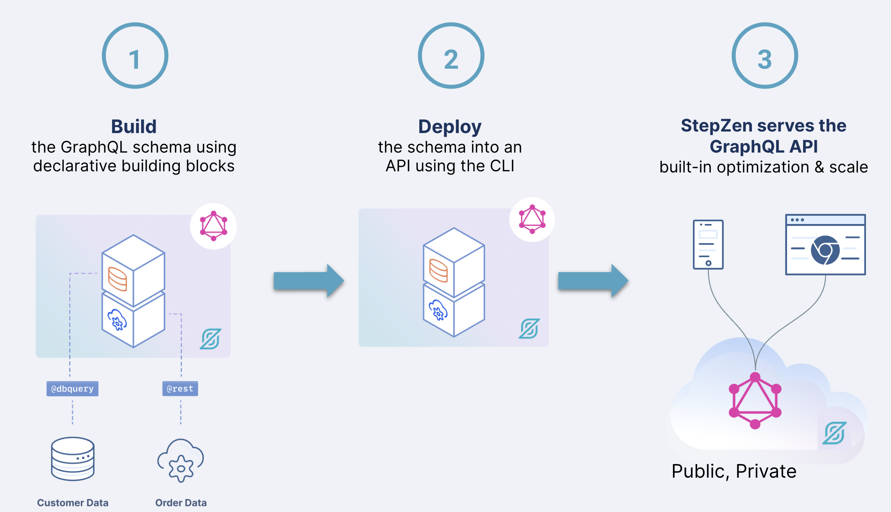
StepZen is a GraphQL server “as a service”
Cloud native architecture
Multi-tenant
Auto-scaling
Declarative development (no-code)
Developer friendly
DevOps friendly

Slide 30
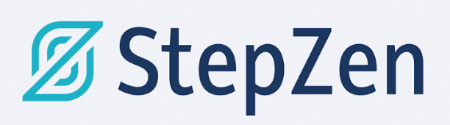
StepZen solves hard problems, so you can focus on value
StepZen is a GraphQL engine
Build GraphQL APIs declaratively (no code)
Introspect diverse backends to easily surface data and services new apps need
GraphQL server runtime
Optimizes the hard problems for you
1 Developer GraphQL-izes backends, easily
Optimization Protection
Scale & Low Latency
Deployment
Caching
Geo Distribution
2 Developer “stitches” the GraphQL-ized backends, easily
3 StepZen does the hard things, transparently

Slide 31
Declarative Development

Slide 32
Introduction to StepZen's Directives
StepZen uses GraphQL schema directives to control how the server processes GraphQL queries.
These custom directives are what enable declarative development with StepZen

Slide 33
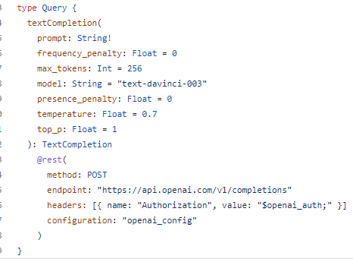
@rest Directive
The @rest directive helps to connect to HTTP services. It can be used to define the URL endpoint and method (GET, POST, etc.) and structure the response data.

Slide 34
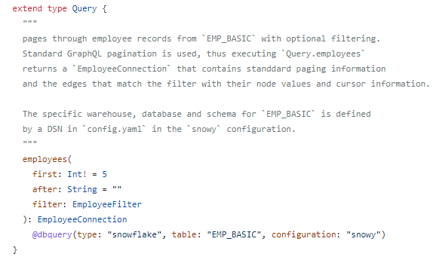
@dbquery Directive
The @dbquery directive allows developers to execute SQL queries on a database. This directive can fetch, insert, update, or delete data in a SQL database.

Slide 35
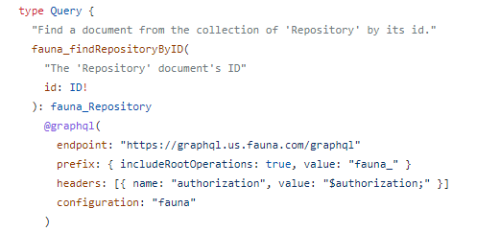
@graphql Directive
The @graphql directive enables developers to connect to existing graphql services and create federated graphs.

Slide 36
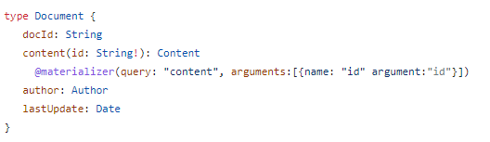
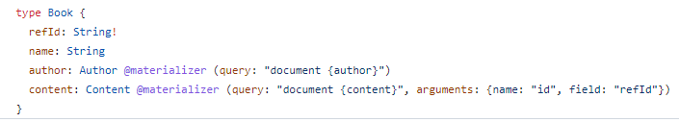
@materializer Directive
The @materializer directive is used to connect types together, allowing developers to “stitch” different systems into a single, unified GraphQL API.

Slide 37
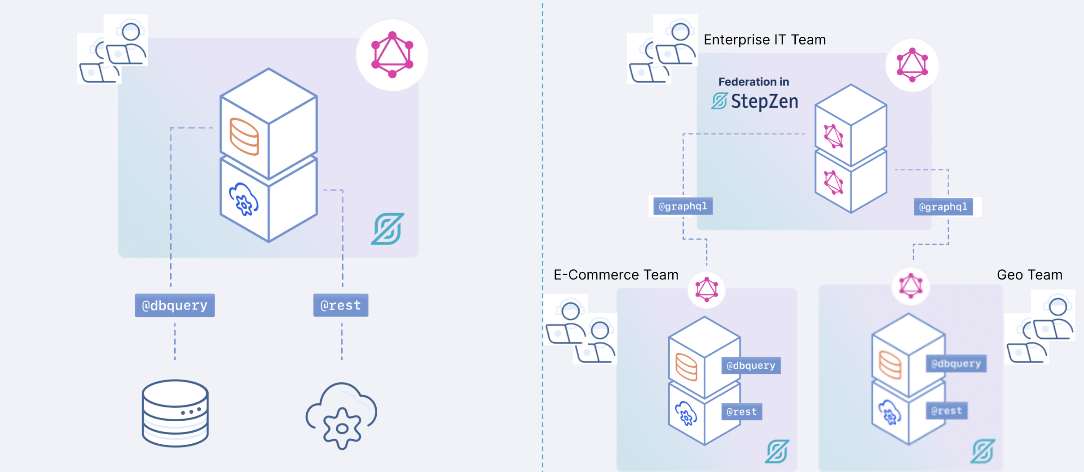
Composition for teams

Slide 38
Composition for teams, and team of teams
Can be built using StepZen, or any other tool. We do not require any special directives to be exposed for federation

Slide 39
Competition

Slide 40
apollo
Strengths:
Well-known name (they will be in most conversations)
Easy to start for free
First-mover advantage. When people think about GraphQL Federation they think about what Apollo says it is.
Weaknesses:
Federation is complex
Implementation of APIs requires writing code, running a server, etc.

Slide 41
hasura
Strengths:
Focus is mostly on DB, very easy to get started with automatic API creation
Weaknesses:
Focus is mostly on DB (difficult to do anything else)
GUI driven only
Scale and maintenance can be difficult

Slide 42
Pricing, licensing, sizing - Newton

Slide 43
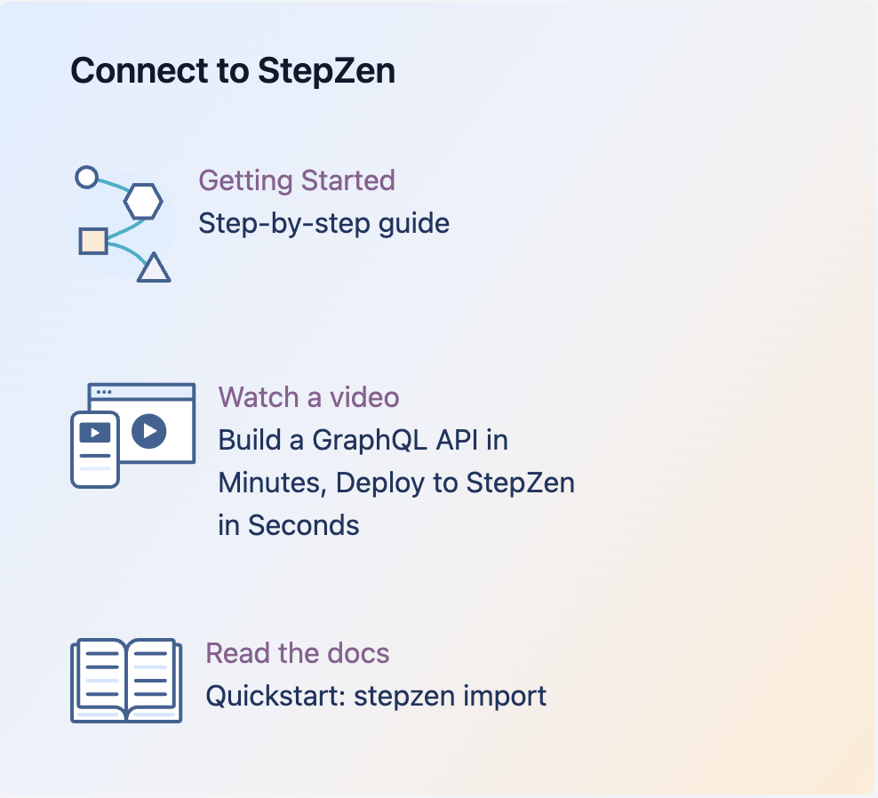
Start for Free
Get started today with building and deploying your own GraphQL Services.
Target:
PoC, MVPs, Growing Skills
Limited:
Deployed Endpoints
Calls Per Month
Not for Production or Other Critical Workloads
https://ibm.biz/try-stepzen

Slide 44
Overview – IBM StepZen Graph Server Essentials
IBM StepZen Graph Server Essentials is delivered as a multi-tenant SaaS offering running on AWS
AWS Datacenters Available at GA
US-East
Frankfurt (EU)
Purchasing options
Multi-tenant SaaS on AWS – can be sold via IBM SQO or AWS Marketplace
IBM StepZen Graph Server Essentials
Targeted at Individual developers or small departments
Community support only
1 Location (AWS Region)
1 Environments
Additional Restrictions: 10 deployed endpoints, 600 TPM (Soft) / 200 TPS Burst (Hard), 50 Concurrent WebSocket Connections, and 1000 MB Max Cache Size
Metric
One Million API Calls
Pricing
$120 per One Million API Calls per Year
Max Discount – 10%
Use by IBM and IBM Business Partners
44

Slide 45
Overview – IBM StepZen Graph Server Enterprise
IBM StepZen Graph Server Essentials is delivered as a multi-tenant SaaS offering running on AWS
AWS Datacenters Available at GA
US-East
Frankfurt (EU)
Purchasing options
Multi-tenant SaaS on AWS – can be sold via IBM SQO or AWS Marketplace
IBM StepZen Graph Server Enterprise Instance
Targeted at an Enterprise use case
Full IBM Support
100M API Calls
1 Location (AWS Region)
5 Environments (eg Test, Dev, Prod etc)
Metric
Instance with add-ons available for API Calls, Locations and Environments
Pricing
$75,000 per Instance per year
Add-Ons:
Locations - $30,000 per Location per year
API Calls - $750 per 1 Million API calls per year
Environments $30,000 per Resource Unit (5 Environments)
Max Discount – 20%
Use by IBM and IBM Business Partners
45

Slide 46
Parts
IBM Offering
Parts | CC Description | Metric | Part Type | Term | Comments | Annual List Price
D0EXAZX | IBM StepZen Graph Server Essentials Million API Calls per Annum | Million API Calls | Subscription | Per Annum | One Million API Calls IBM Community Support 99.9 SLA | $120
D0EX6ZX | IBM StepZen Graph Server Enterprise Instance per Annum | Instance | Subscription | Per Annum | Instance defined as: 1 Region (Location), 5 Environments, 100M API Calls | $75,000
D0EX8ZX | IBM StepZen Graph Server Enterprise Add on Location per Annum | Location | Subscription | Per Annum |  | $30,000
D0EX9ZX | IBM StepZen Graph Server Enterprise Add on Resource Unit per Annum | Resource Unit | Subscription | Per Annum | Resource Unit =5 Additional Environments | $30,000
D0EX7ZX | IBM StepZen Graph Server Add on Million API Calls per Annum | Million API Calls | Subscription | Per Annum | One Million API Calls | $750
D0EXBZX | IBM StepZen Graph Server SLA SVC Level Agreement |  | Service Level Agreement | Per Annum |  | $0
Use by IBM and IBM Business Partners

Slide 47
Call to Action - Brian & Tom

Slide 48
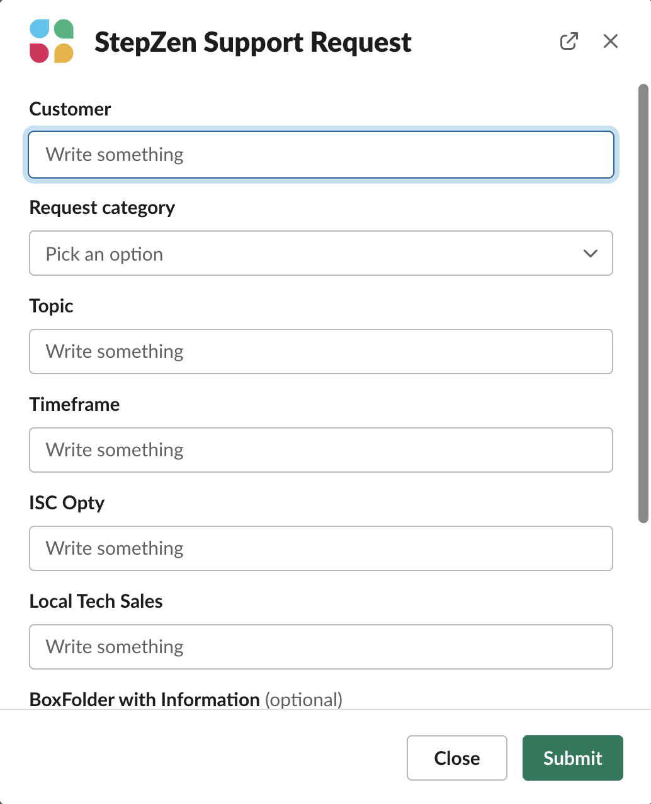
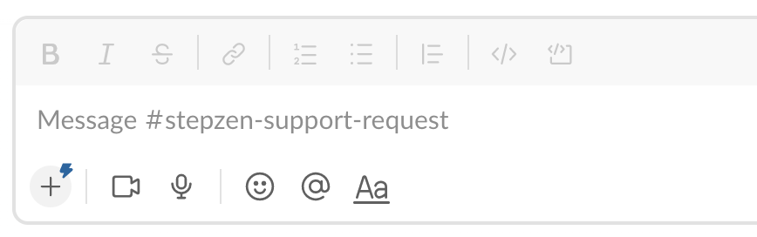
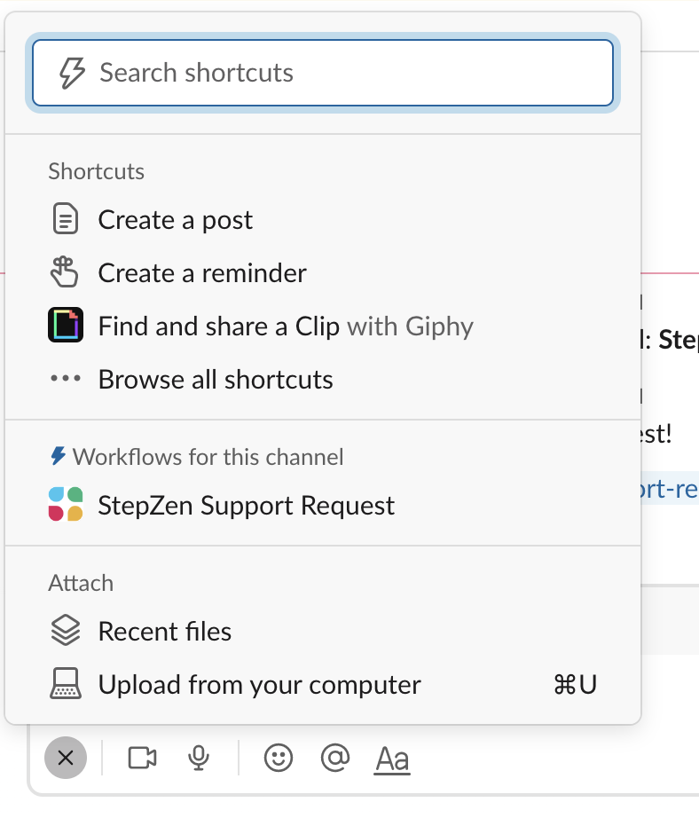
How Do I Get Technical Assistance on My StepZen Opportunities?
A Slack channel #stepzen-support-request is available IBM Software workspace
https://ibm-cloud.slack.com/archives/C053J4UHF89
People/Users can not post messages in the channel.
The only option is to start a workflow by clicking here.
The workflow is called “StepZen Support Request”.
1
2
Instructions to use this Form can be found here

Slide 49
This was just a taste. Now get the full meal… Full learning course on StepZen available over the next month.
Module 1 – Selling StepZen, Speaking confidently
Module 2 – Architecture, white boards, and doing quick demos
Module 3 – Common scenarios, making a custom demo
Module 4 – StepZen directives
Module 5 – Everything else--Governance, CI/CD, Testing

